Slide 1

Introductions
2024

Slide 2





Bringing customers
closer.
ACF Technologies Inc. is a technology company born in Asheville, USA in 2003.
With 20 years of experience across multiple industries including Retail, Banking, Government, Healthcare, our mission is to bring customers closer with our best-in-class customers experience solutions.

Slide 3




7
offices
30
countries
150
employees
500
customers
30,000
locations

Slide 4







Our Approach
Design
Listen
Tailored solution.
Business drivers.
Document and sign-off.
Listen to understand.
Challenge where needed.
Attention to detail.
Build
Analyse
Dedicated project team.
Security & GDPR.
Agile approach.
Historical data analysis.
Trends and forecasting.
ROI analysis.

Slide 5

Boots Case Study
Challenge
High volume of no-shows to appointments
Insufficient real-time reporting
Decreasing store footfall
Solution
Omnichannel appointment booking solution
API used for full integration with IT applications
Campaign Engine for executing mass promotions
Results
Optimised appointment model for 2,000+ stores
Reduction of no-shows by 18%
Ongoing technology partnership for 7+ years

Slide 6
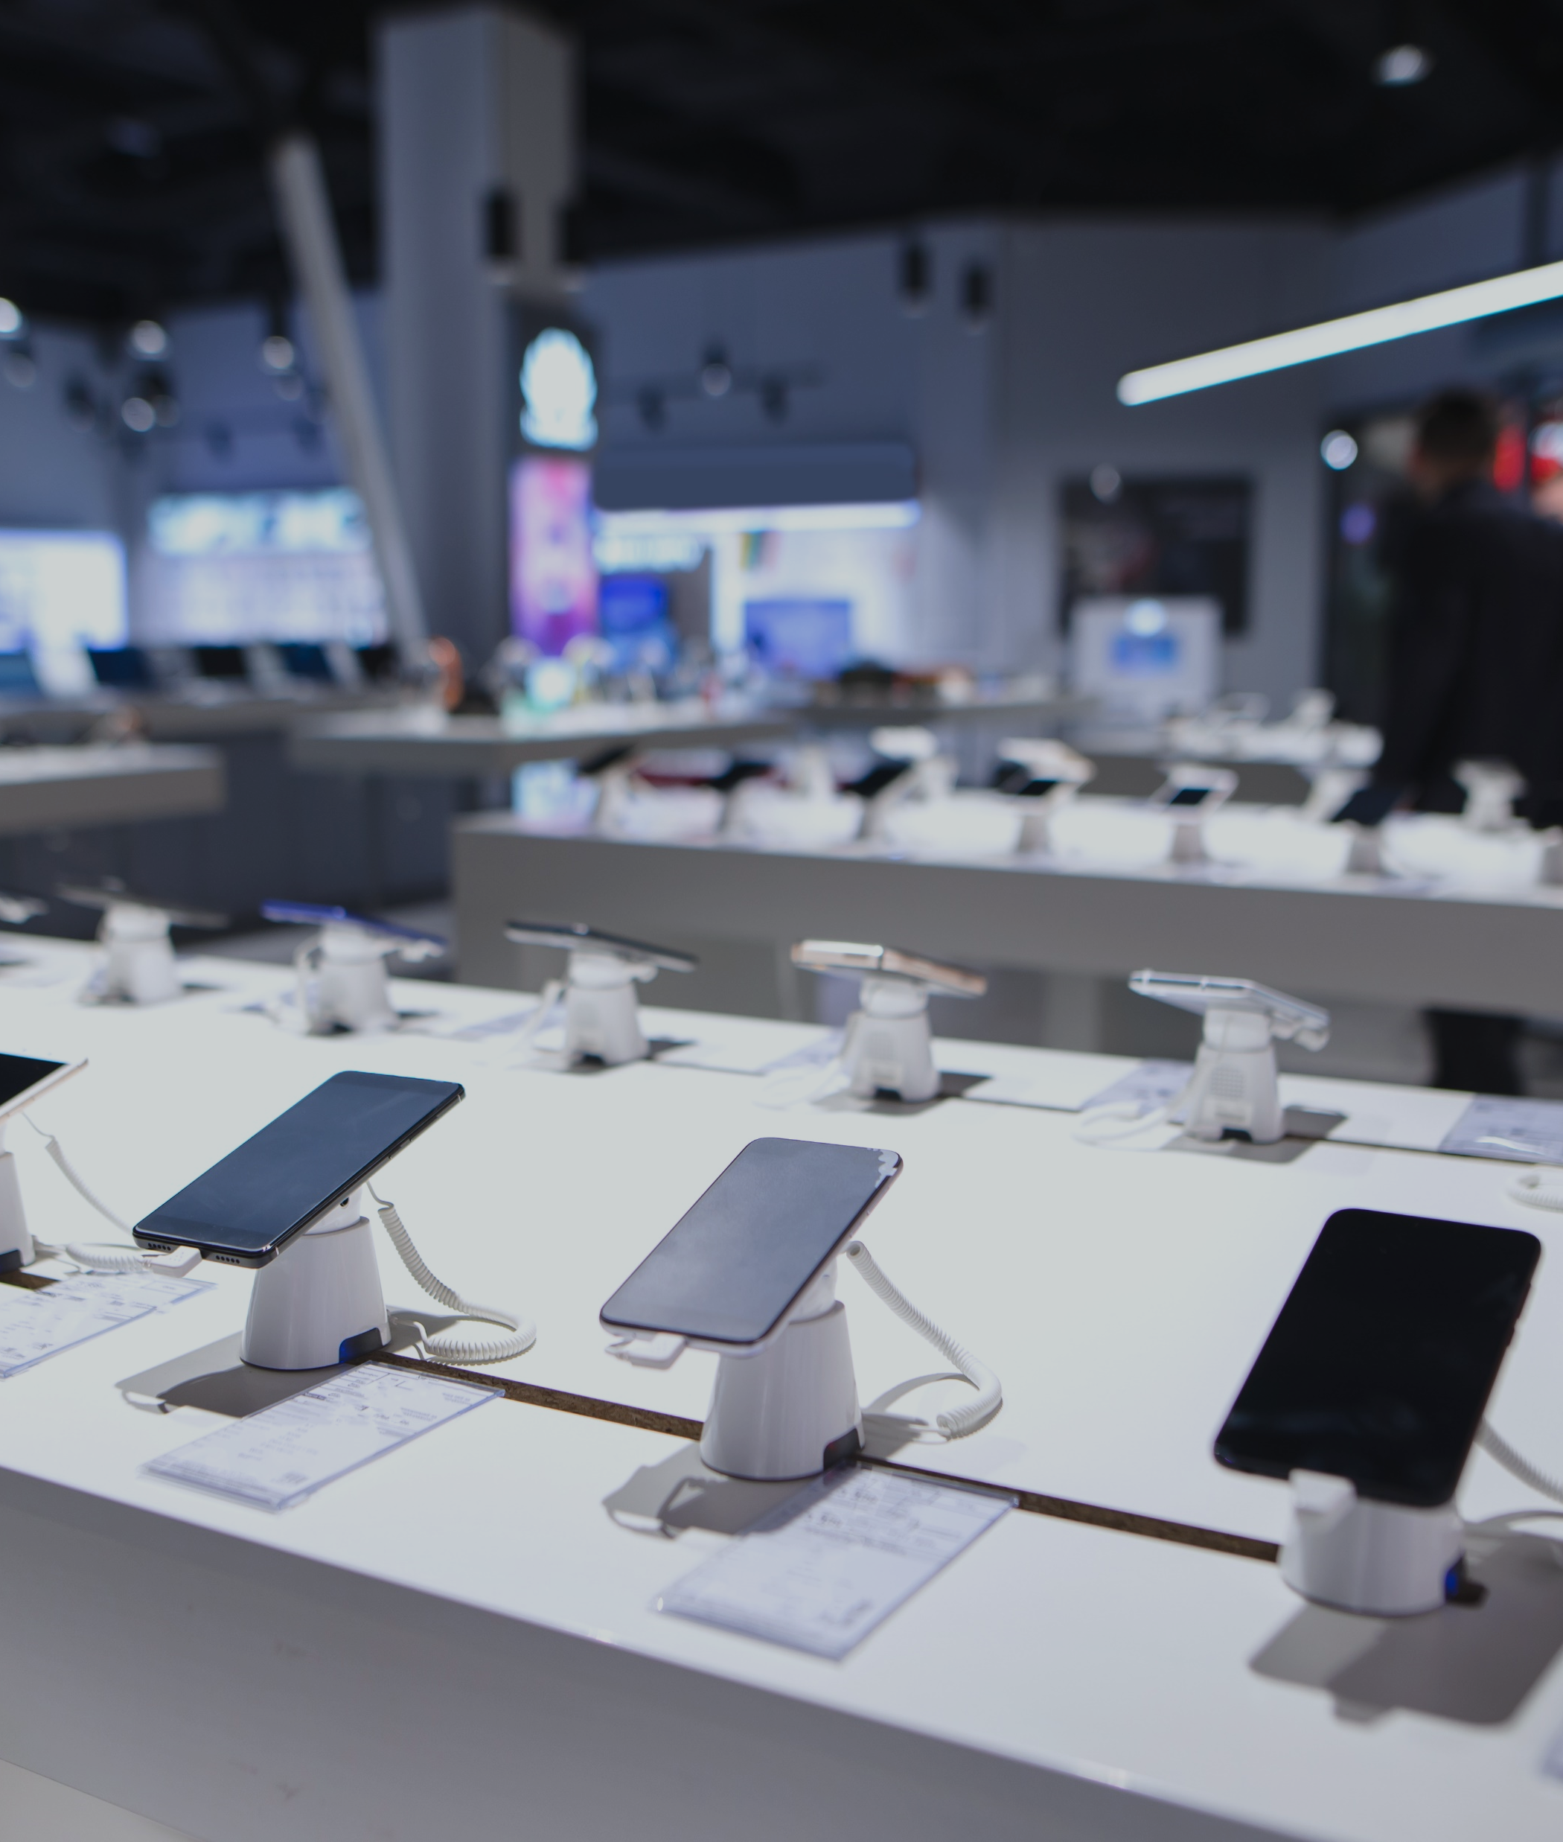

Select Case Study
Challenge
Appointment system for premium Tech Support service
Consistent brand experience for in-store, video & phone
In-store events to increase traffic and revenue
Solution
Omnichannel appointment booking system
Video calling system, with recording, storage and chat
Event booking solution for in-store and online events
Results
Increased revenue with paid-for events & Tech Support
Elevated brand experience for customers
Enabled a de-centralised support team using virtual service

Slide 7
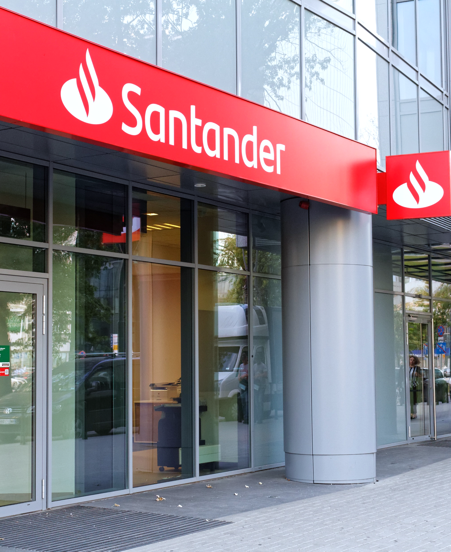
Santander Case Study
Challenge
Create consistent brand experience across all channels
Inefficient diary utilisation for 10,000 staff calendars
Lack of data insights to drive decisions
Solution
Omnichannel online appointment booking solution
Automated calendar optimisation promoting efficiency
A full customer journey experience
Results
Optimised in-branch appointments for 500+ locations
Significant increase of staff calendar efficiency
Successful technology partnership for 6+ years

Slide 8
Our solutions

Slide 9
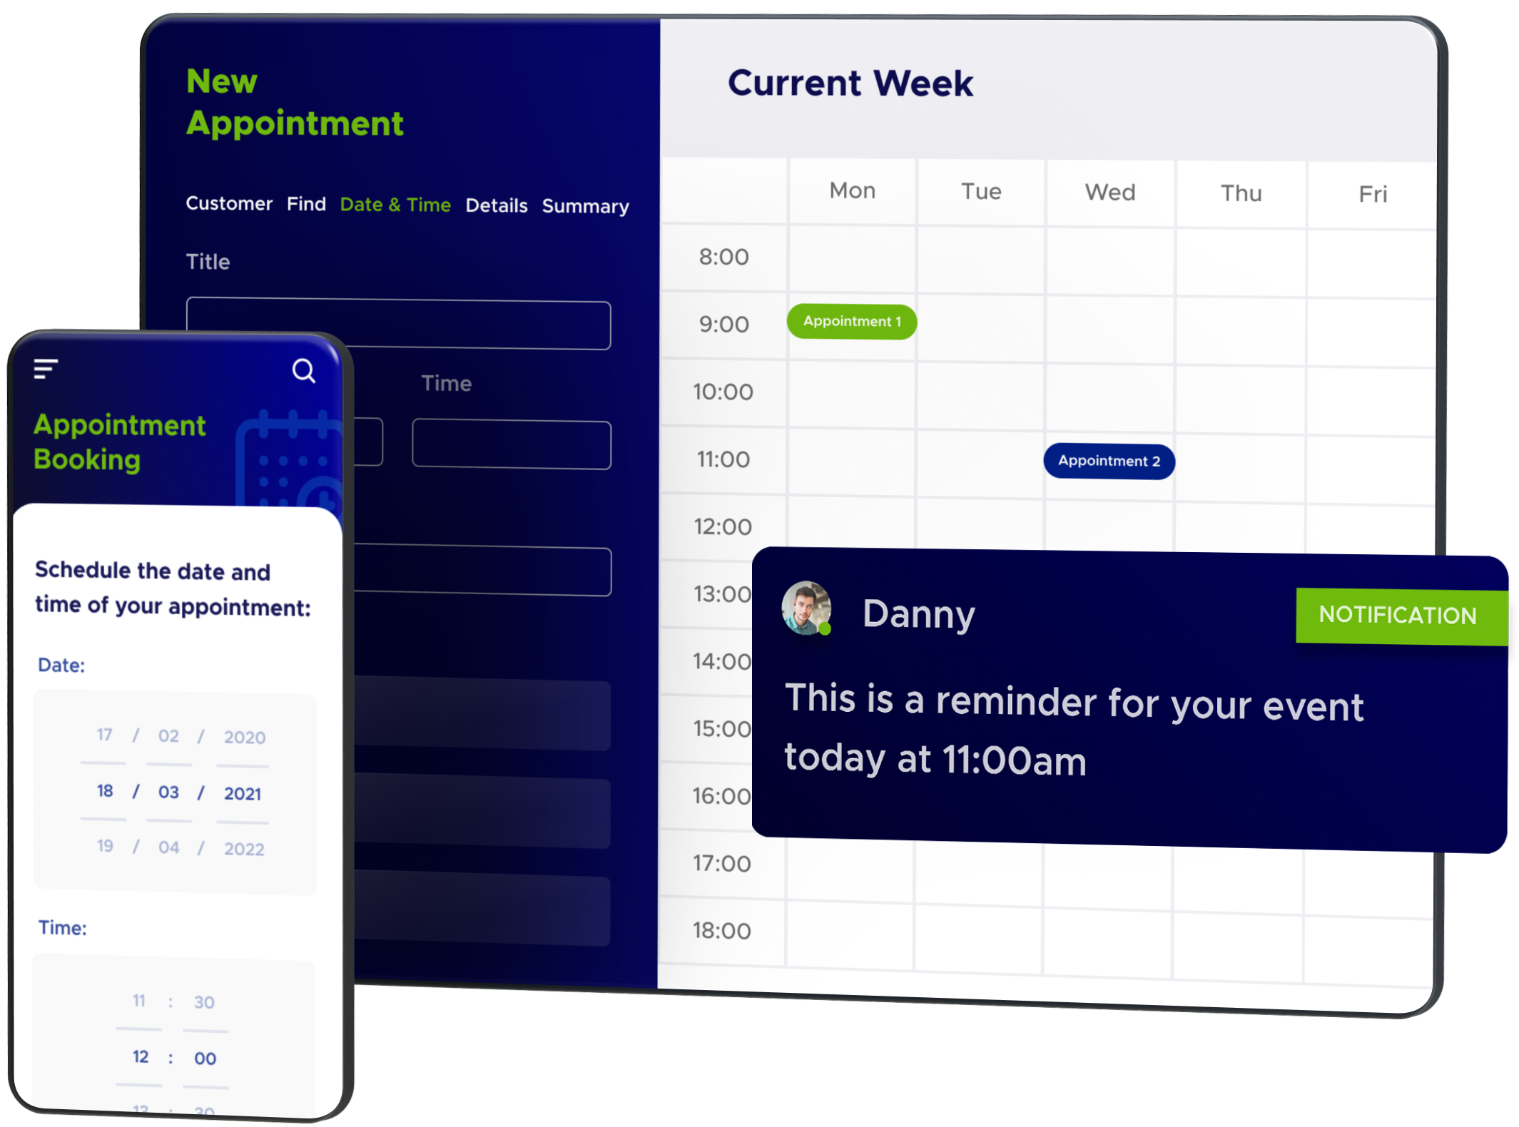
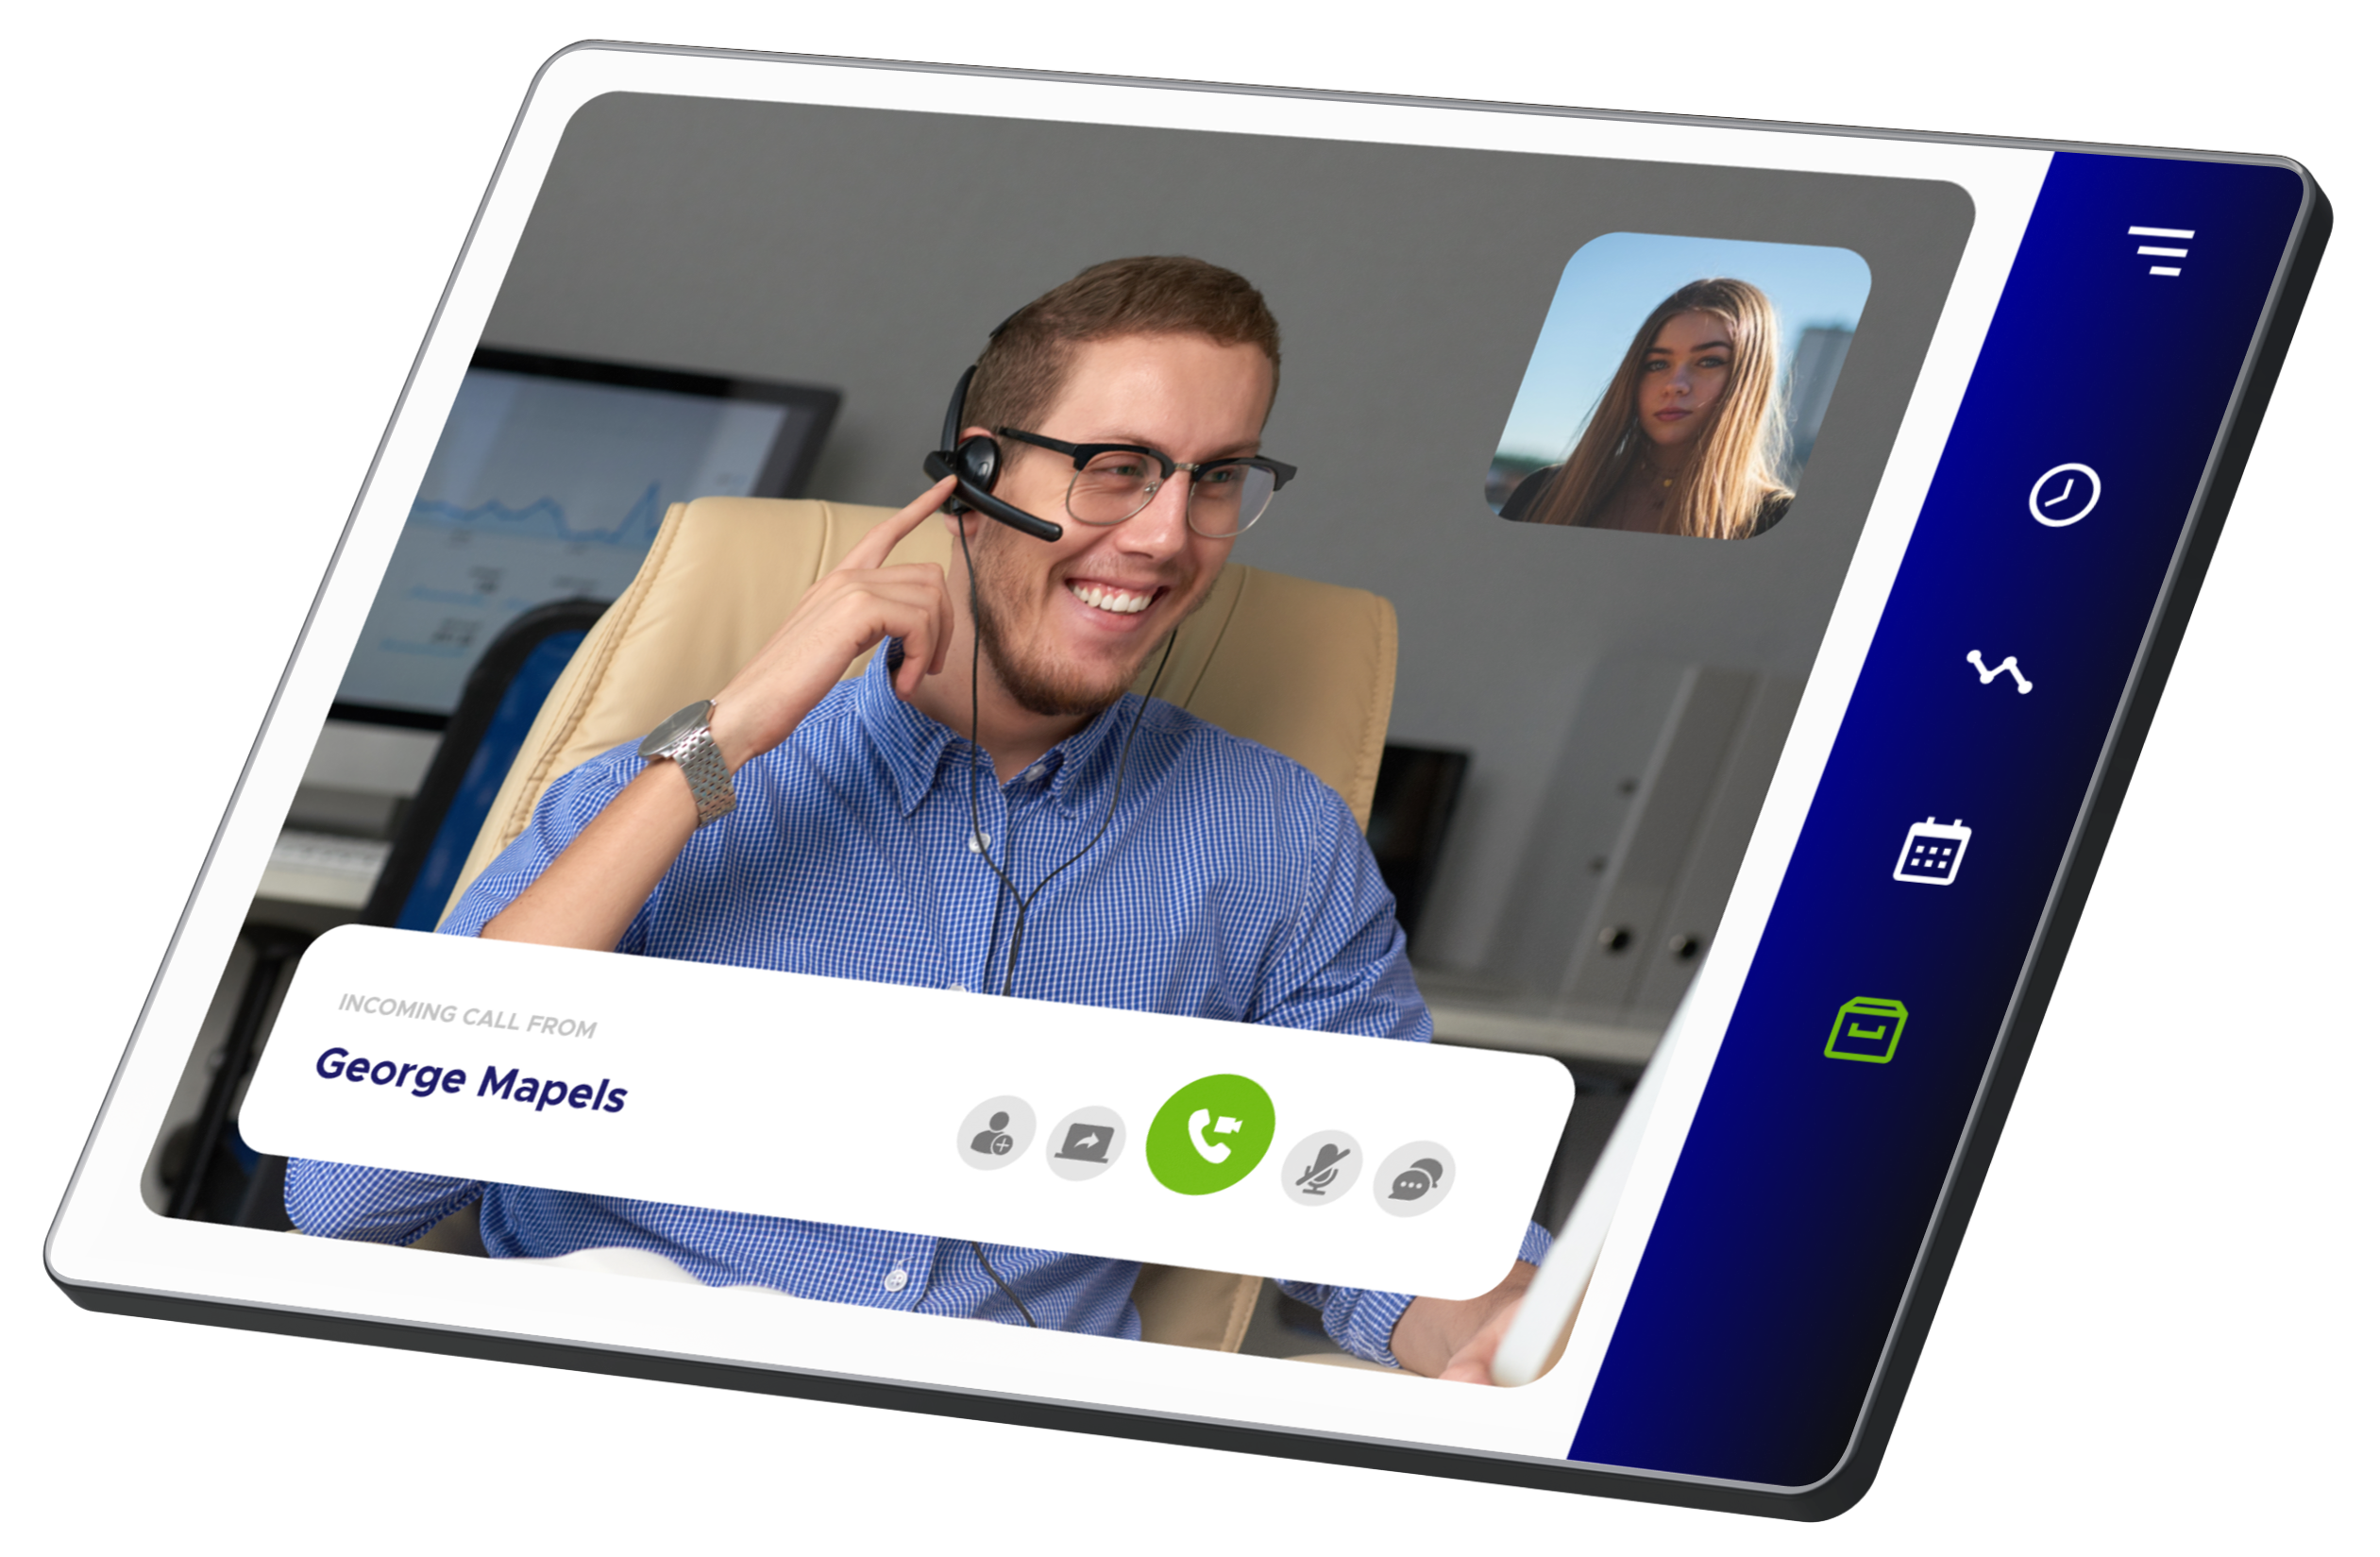
Companies with strong omnichannel strategies retain 89% of customers vs. 33% for weak strategies.
Transforming the customer journey across omnichannel
Appointments
Omni-channel booking, amending, cancelling & serving
Automated, personalised & contextual notifications
Intelligent calendar management for people & resources
Operation Room / Theatre management
Fully branded and tailored to your patient flow
Video consultations / Live shopping
Virtual patient to staff video calling
WebRTC (browser-based), Teams or Zoom
Chat, share-screen, rotate camera, share links
Recording and storage of calls
High quality video and audio
Notes:
83% - source: Hedges, 2020. 90% - source: Parker & Chia, 2021. 68% - source: Accenture 2019.

Slide 10
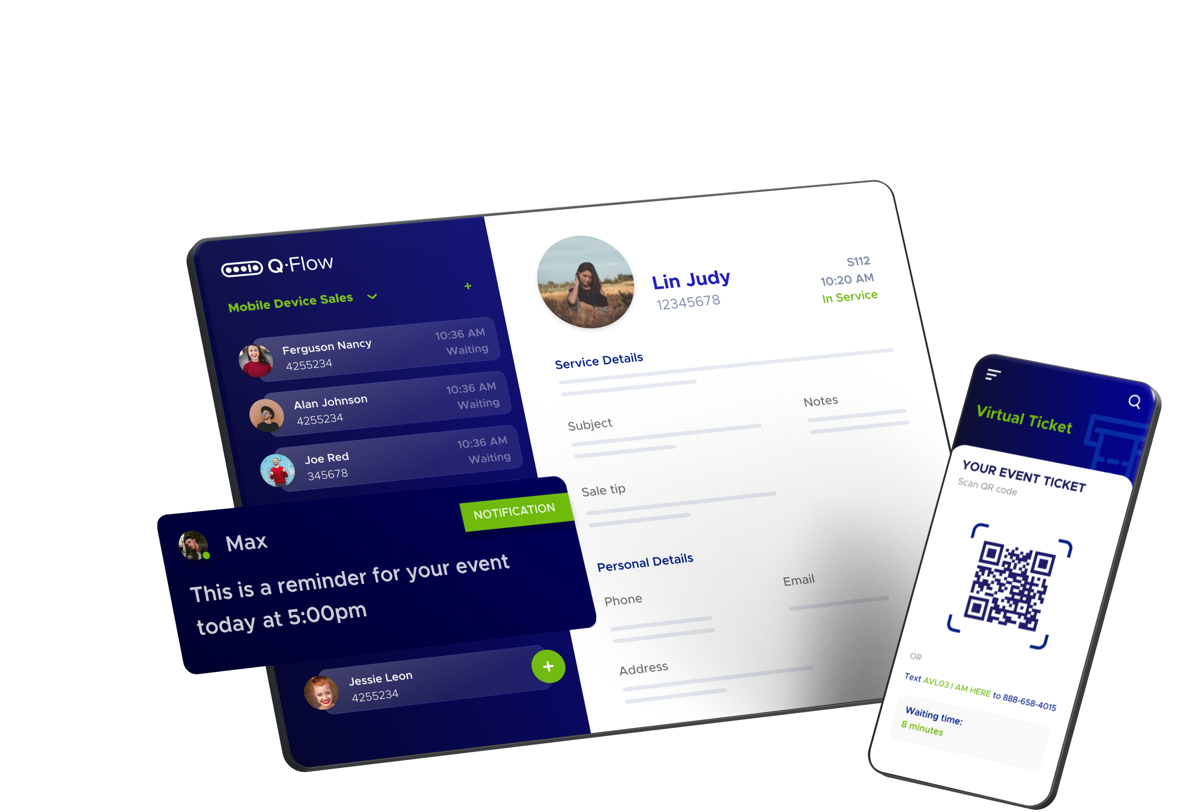
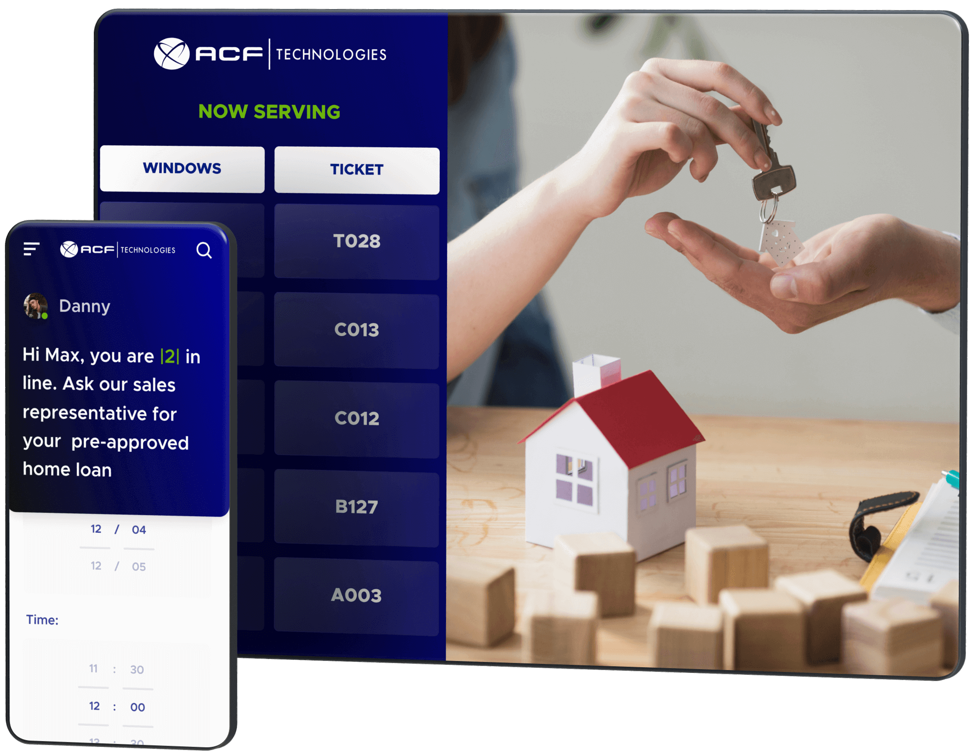
Over 40% of customers feel they become more loyal to brands after attending their events.
Increasing footfall and creating a community
Event Booking
Create and promote in-store or virtual events
Automatic communications via email, SMS or push notifications
Real-time reporting of event success
Fully branded interfaces for a consistent brand experience
Ability to create a community around stores
Campaign Engine
Create lists of clients and invite for appointments or events
Empower managers to send personal invitations
Execute personalised email marketing campaigns
Increase footfall to physical & digital channels
Notes:
83% - source: Hedges, 2020. 90% - source: Parker & Chia, 2021. 68% - source: Accenture 2019.

Slide 11
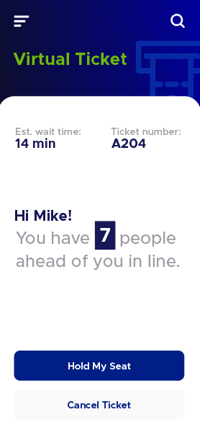
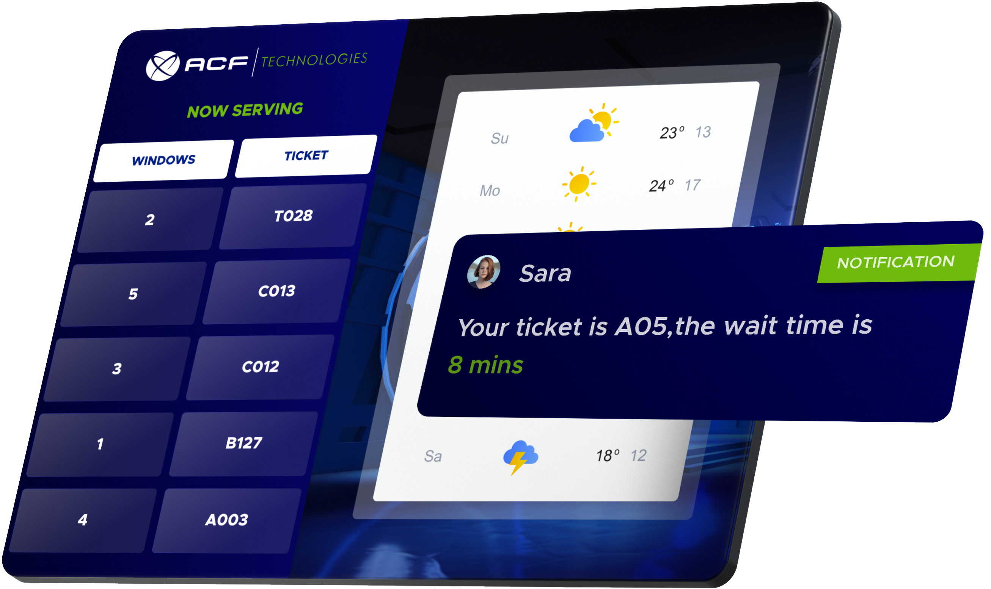
57% of customers are willing to wait longer if given the option to wait in virtual queues.
Increasing efficiency in busy environments
Queue management
Join a queue or check-in for appointment
Kiosk or staff interfaces both offered
Intelligent routing to best ‘skills and needs’ matching
Digital signage and audio announcements
Integrations for identification or payment processes
Virtual queue management
Join queue virtually via webpage or SMS
‘Personal Info Page’ shows position and wait time
Ability for customer to delay service or abandon queue
Utilise QR codes to create a simple journey
Advertise to customers whilst they wait
Notes:
83% - source: Hedges, 2020. 90% - source: Parker & Chia, 2021. 68% - source: Accenture 2019.

Slide 12
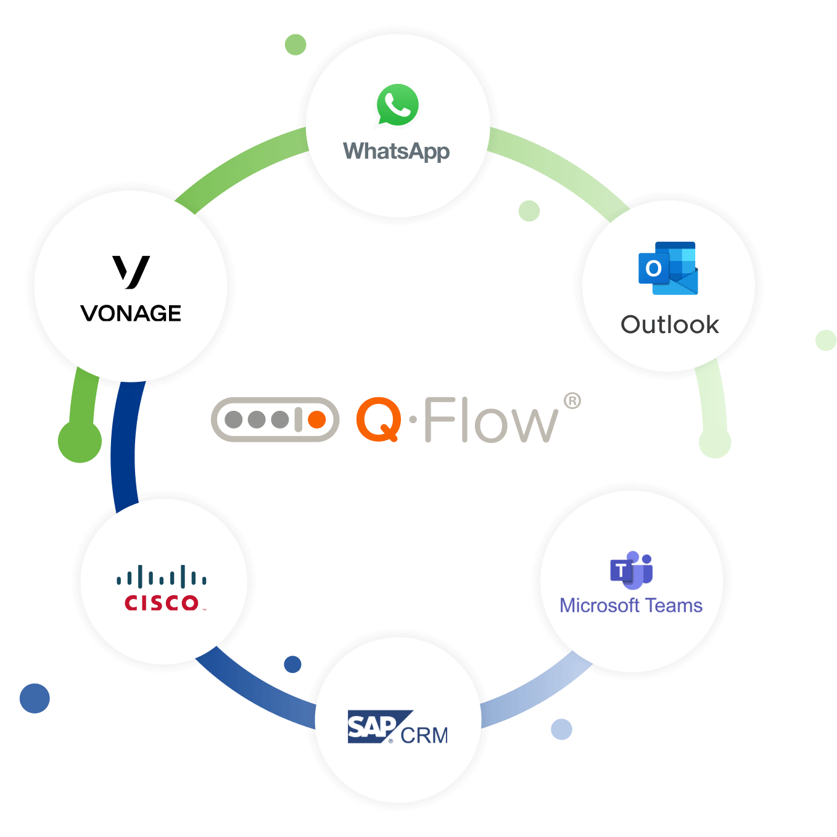
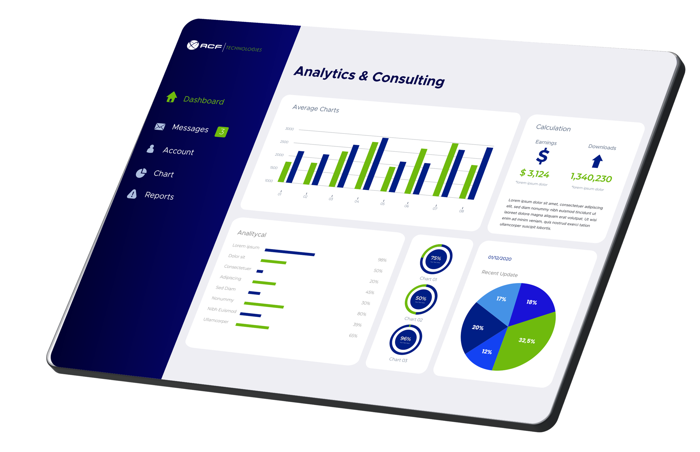
80% of customers are more likely to make a purchase when brands offer personalised experiences.
Automation and insightful data
Workflow & integrations
Create workflows alongside interactions
Pass data to and from 3rd party applications
Digitise steps using webforms for data collection
API, webhooks and scripting layers
Data & insights
85+ reports ready to use
Report builder enables custom dashboards
Historic, present and prediction data
Connect data to central data warehouse or BI tool
Notes:
83% - source: Hedges, 2020. 90% - source: Parker & Chia, 2021. 68% - source: Accenture 2019.

Slide 13
Quantifying the value we bring
1
2
3
Enhanced customer experience
Streamline business processes
Data, insights & decisions
Increased satisfaction & retention
Streamlined processes & resources
Quantified service statistics
Improved brand consistency
Automation of communications
Identify opportunities & training needs
Reduced dropouts & failures
Increased utilisation of resources
Forecast demand and identify trends
AT&T
40% reduction in no-shows
Boots
18% less cancellations
Northampton Council
16% quicker service time

Slide 14
Thank you. www.acftechnologies.com

